Slide 1
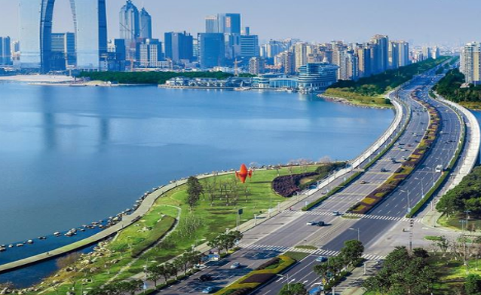
Sustainable Development
Building the Human Element of
Sustainable Cities
Fritzroy Wilkin
TVET Expert
Clarence Fitzroy Bryant College
Basseterre, SKN
OAS Training Workshop on
Building Sustainable Cities
Nathaniel – John Hospitality Centre, CFBC, St. Kitts May 31 – June 3, 2017

Slide 2
Building Sustainable Cities…
RECOGNIZING:
A reduction in waste
Emerging knowledge societies;
Rapid spread of ICT;
Effects of global crises and change;
Demands for higher‐level TVET skills;
Socio-economic developments and trends;
Poverty, exclusion, deprivation, marginalization;
Food insecurity and limited access to health;
Conflict and disaster
Context

Slide 3
Resonates with other calls…
Greening TVET, Jobs & Industries
Peace andprosperity
Global
Competitiveness
National Level
Recognize + Resonates
Best asset
for Sustainable City is the
Human Resource
Human Element
Right attitude to work

Slide 4
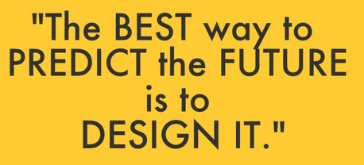
Type: Right State of Mind
Find remedies, not faults
By: Buckminster Fuller
Transformational Leaders
Environmentally Conscious

Slide 5
Reforming Human Capital
"Our progress as a nation can be no swifter than our progress in education. The human mind is our fundamental resource.”
John F. Kennedy
http://www.buzzle.com/articles/why-is-education-so-important.html

Slide 6
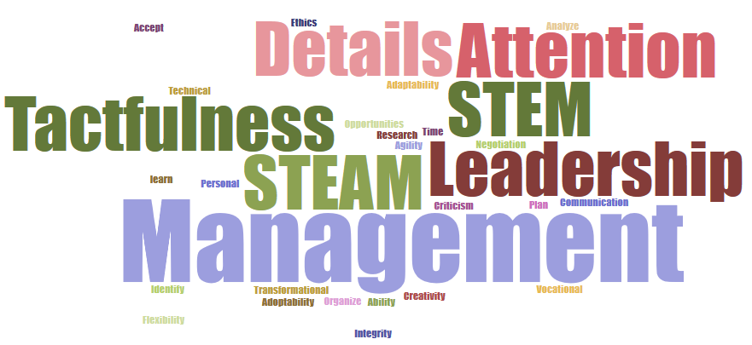
Knowledge & Skills to energize Sustainable Cities
Developing transferrable skills with the right attitude
is a strategy for sustainability and survival.
They prepare you to change with change!

Slide 7
Guiding Principles & Policies
Integrate and assess environmentally friendly attitudes in our training programmes.
Merge/Integrate environmental awareness and sustainability. skills with the critical employability skills.
Make sustainable development all inclusive (All levels of society, all programmes).
Establish a mechanism to review.

Slide 8
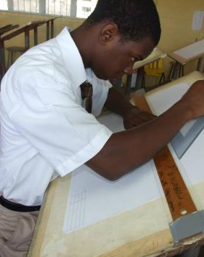
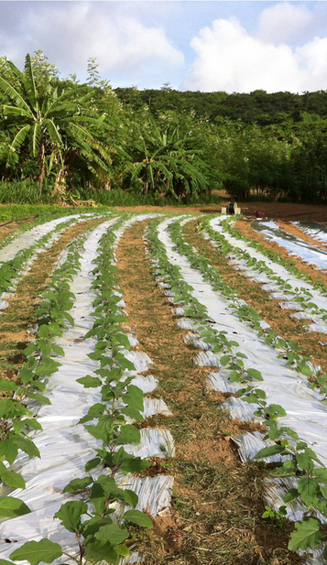
Strategy for building Sustainable Cities
Eight (8) measurable targets for sustainability
S
T
R
A
T
E
G
Y
Set clear goals and objectives
Train to Target
Raise the bar
Adopt a consistent approaches
Taskforce (implement)
Assess & Evaluate properly
Goal oriented
Yield Results
Sustainability
Right Skillsets
Accept quality
Standards
One Voice
Right Measure
Right Focus
Eco-Friendly communities
Be consistent with how we measure success

Slide 9
Conclusion
Building Sustainable Cities starts with
What and How we Think!

Slide 10
References
http://archive.rec.org/REC/Programs/SustainableCities/Characteristics.html
http://www.oas.org/en/sedi/DSD/Biodiversity/Sustainable_Cities/Sustainable_Communities/Events/SC%20Course%20St.%20Kitts%20Nevis%202017/CourseSustanaibleCitiesEdition10.asp
Sustainable Communities in Central America and the Caribbean
ECPA Webpage
Sustainable Cities Collective
https://www.compactofmayors.org/
https://cleantechnica.com/2015/01/02/makes-sustainable-city-thoughts-key-components-future-sustainable-cities/
http://www.bbc.co.uk/schools/gcsebitesize/geography/sustainability/sustainable_living_rev1.shtml
https://sustainabledevelopment.un.org/topics/sustainablecities
http://masustainablecommunities.com/previous-conferences/2016-conference/
http://www.thegreenspotlight.com/quotations/
CEFE section 9 p. 10

